Slide 1


TOTAL HEALTH:
An Android Application to help you achieve fitness goals

Slide 2
Agenda
>> Project Overview
>> Application Features
>> Project Design
>> Technologies Used
>> Future Research
>> Results and Summary

Slide 3


MEET THE TEAM
Under The Guidance of Professor
Spriha Deshpande
Gaurav Debnath
Kajal Agarwal
Gheorghi Guzun

Slide 4

Project Overview

Slide 5
Drivers for This Project:
Health Concerns: Health degradation due to environmental pollution, Increase in the number of chronic diseases.
Lifestyle Practices: Failure to maintain work life balance.
Food Habits: Consuming unhealthy and junk food

Slide 6

Application Features

Slide 7
Features:
SetGoals: Allows the user to set and modify goals
Nutritional Diary: Keeps a track of calories intake by the food consumed by the user.
Activity Monitor: Tracks the activities performed by the user for goal achievement.
Analytical Dashboard: Graphical view of activity and calorie intake data.
Group Creation: Invite friends to create a group.
Share a Run: Invite others to perform a workout activity together.

Slide 8
Database Architecture
Machine Learning Model
Design Flow
Project Design

Slide 9
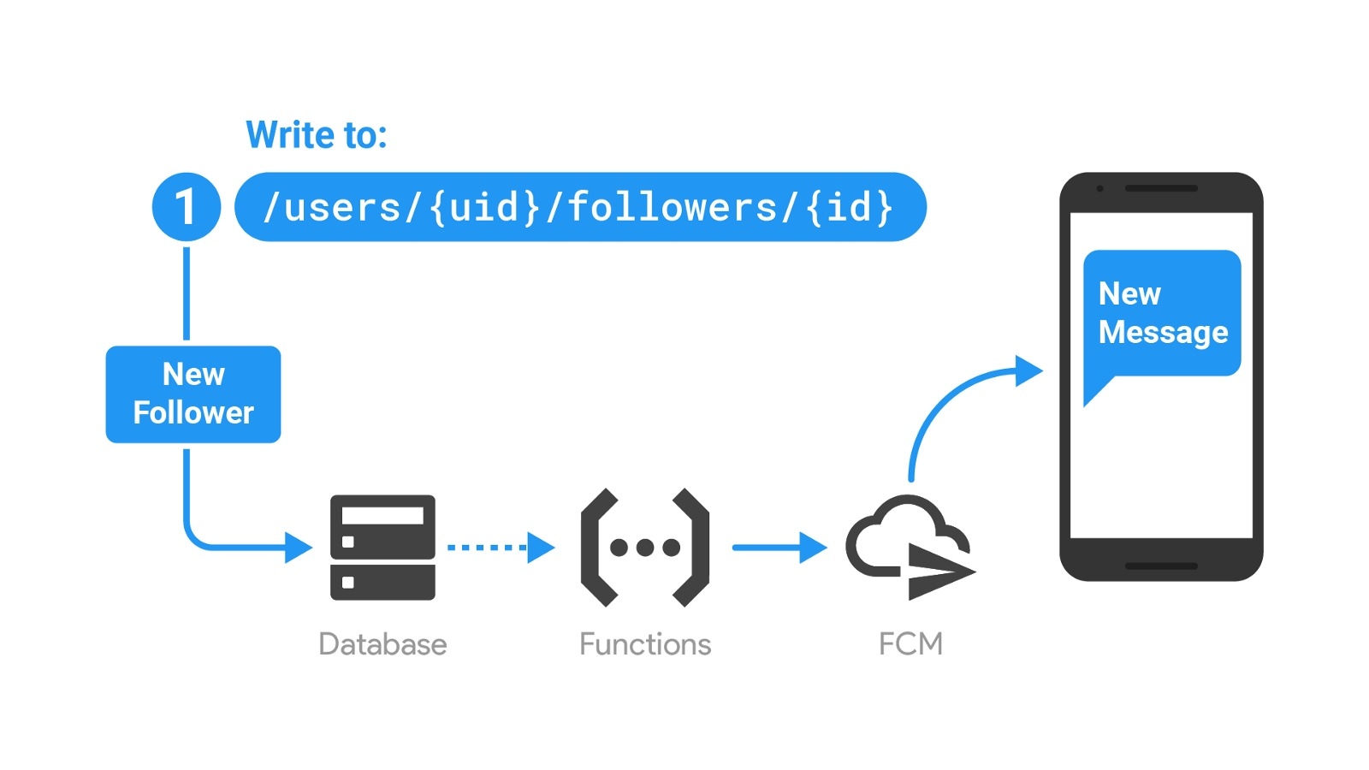
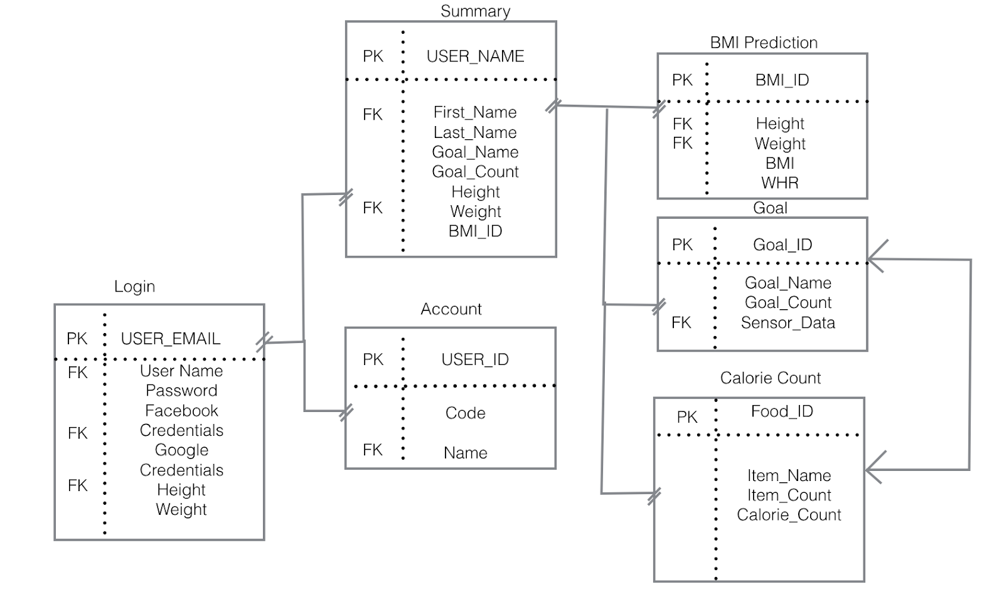
Database Architecture:

Slide 10
Machine learning model: Weighted Majority Algorithm
Supervised learning model.
Fragments modules according to decision tree model.
Application uses Weighted majority algorithm to take attributes of BMI and WHR to provide prediction about fitness goal achievement time.

Slide 11
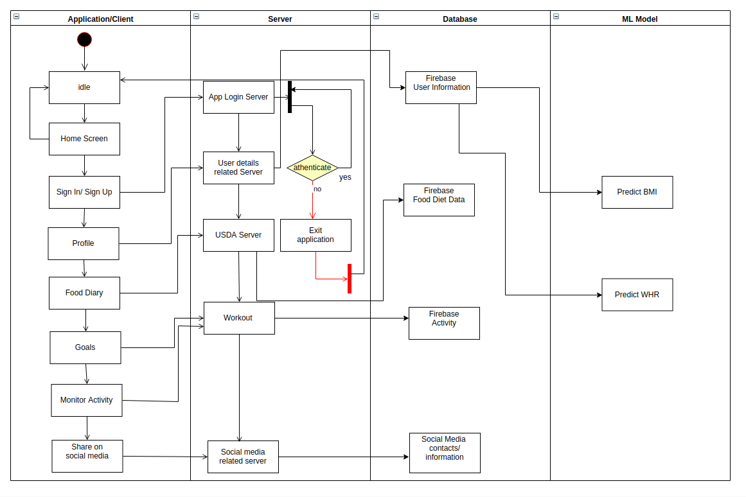
Design Flow:

Slide 12
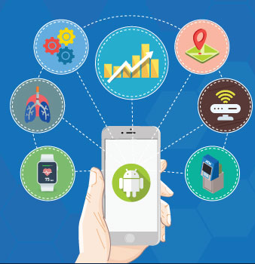
Technologies Used

Slide 13
Technologies Used:
Client Technologies:
Android Studio
Frontend Design using XML
Google API
NDB API
Server Technologies:
Google Firebase
JSON
HOOPS 3D
JAVA
Machine learning Technologies:
Amazon Comprehend
Python NumPy
Pandas

Slide 14

Results And Summary

Slide 15
Results and Summary:
Standardized model design for users with different health and diet routine plan.
Track and record the personal fitness of the User.
BMI and WHR Calculation
Prediction using Weighted majority Algorithm

Slide 16

Future Research

Slide 17
Future Research:
Making the application platform independent.
Prediction analysis based on the attributes like smoking and drinking.
Including various cuisine options for food categories for the application to be universally acceptable.
Integration of ECG data from smartwatch with the application to allow better health monitoring.

Slide 18
Thank You

